Slide 1
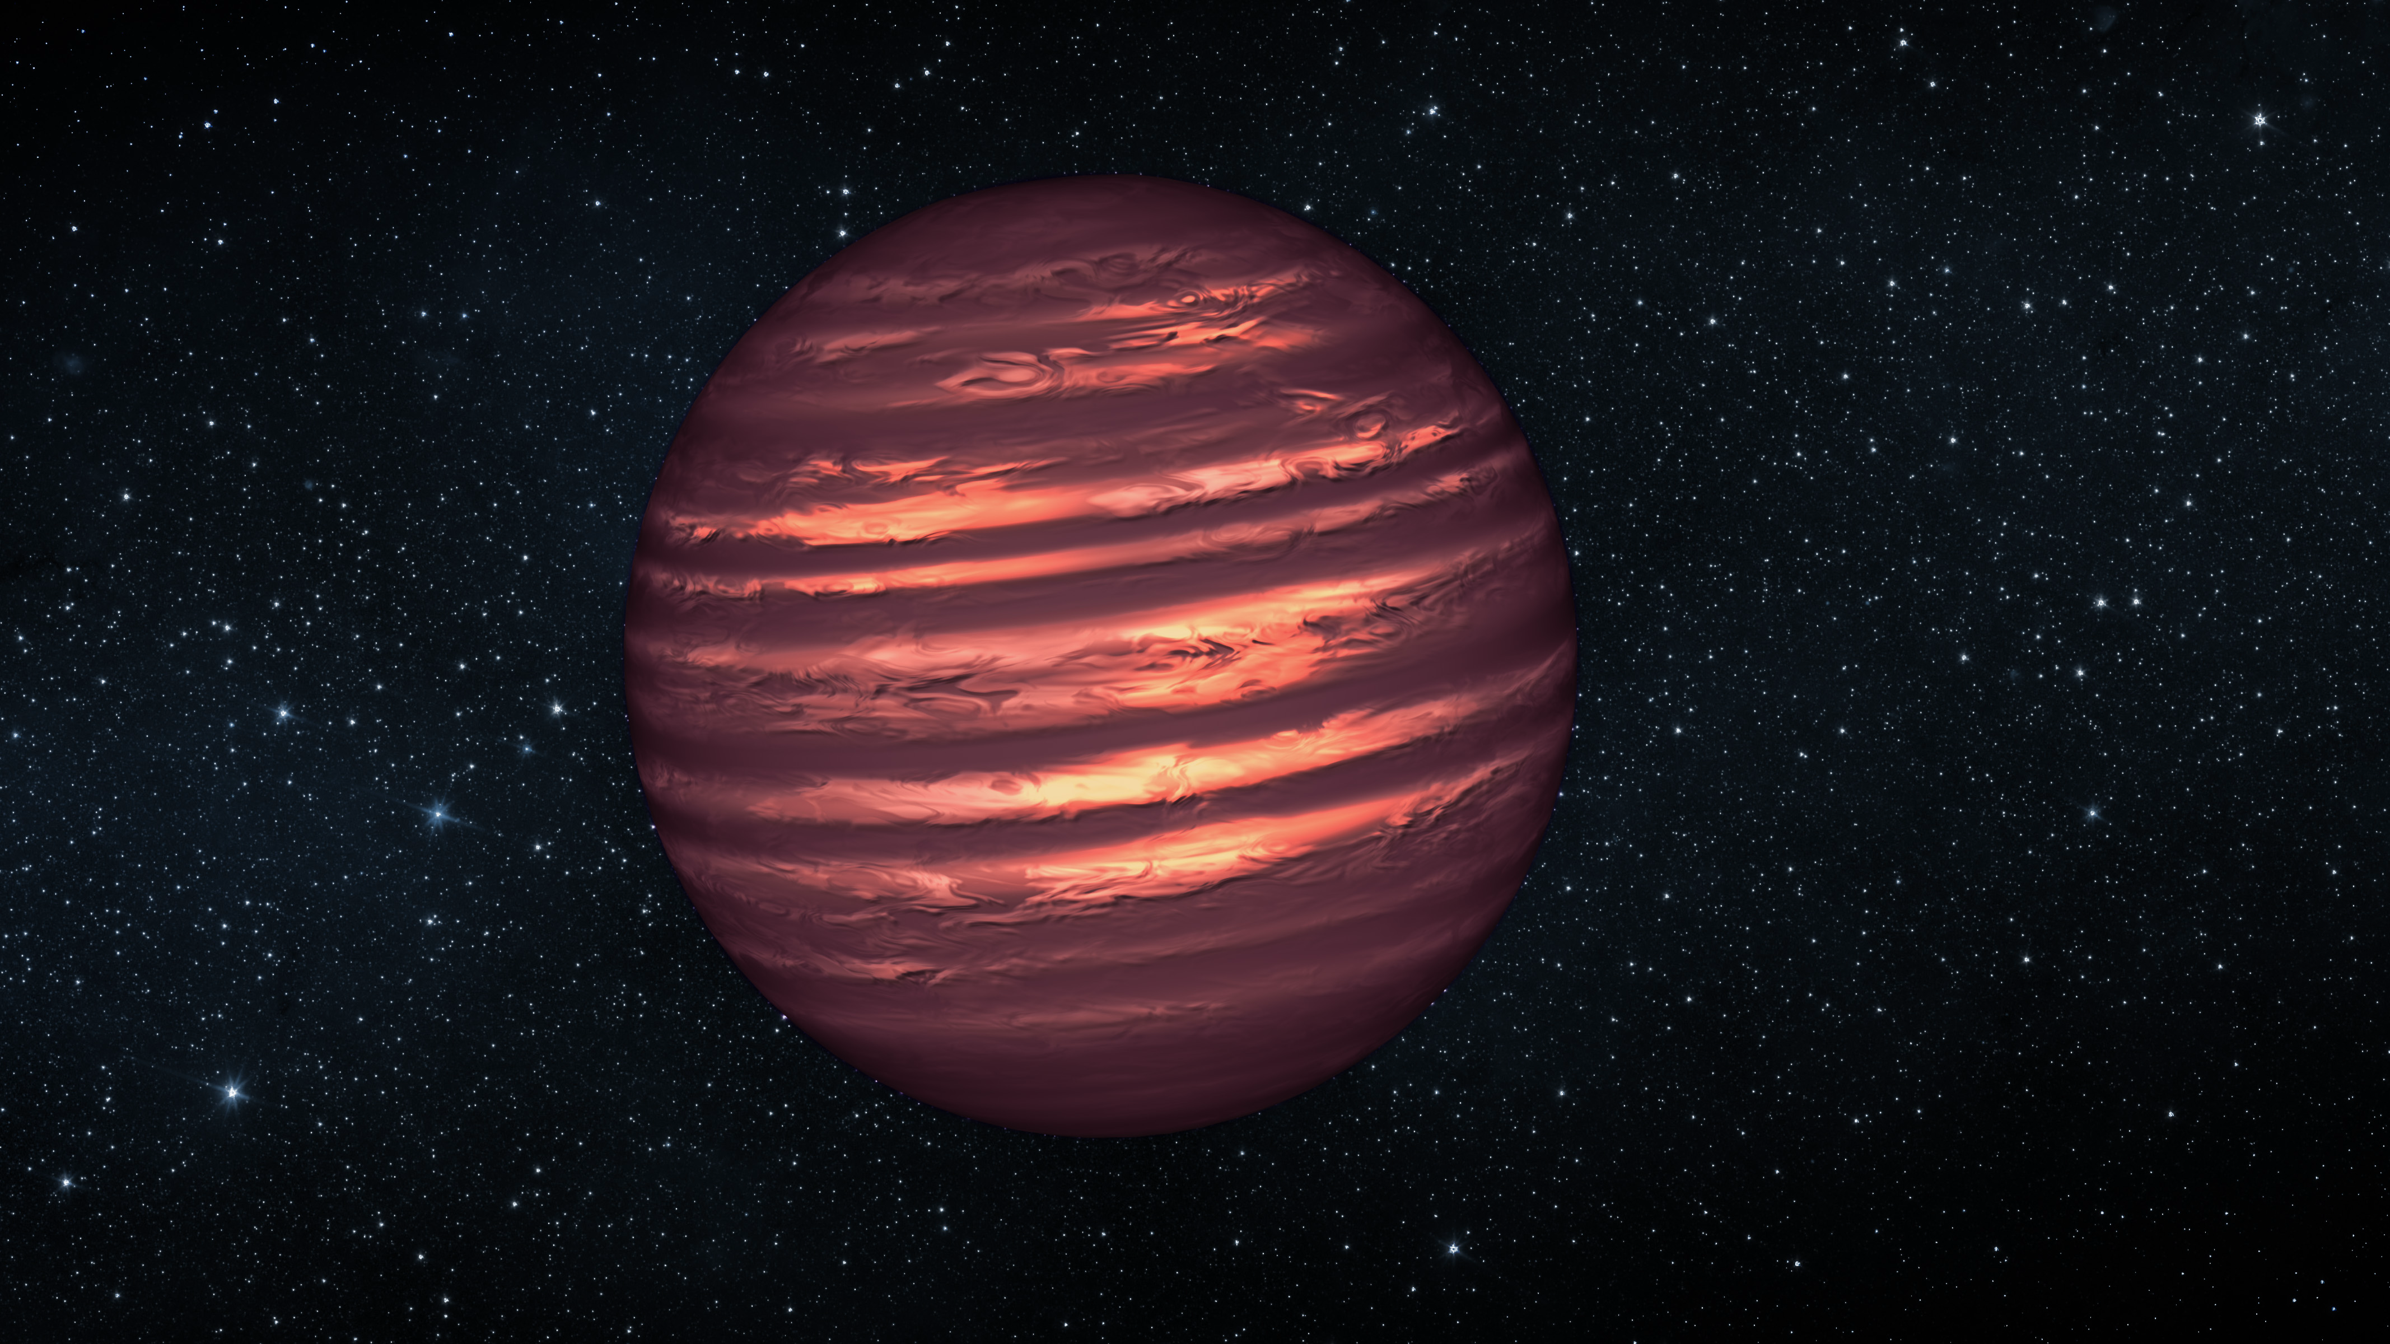

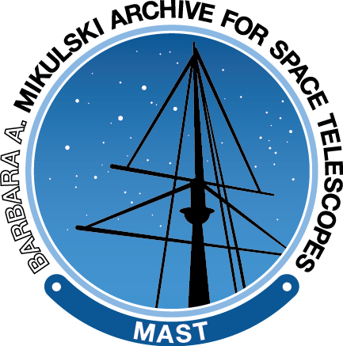

SIMPLE
A collaborative database solution for brown dwarf science
David Rodriguez
& the SIMPLE collaboration
Nov 15, 2022

Slide 2
Outline
Getting into Data Science
A brief primer on Brown Dwarfs and Databases
The SIMPLE Database & Ecosystem
The SIMPLE Website
Backend/Content Details

Slide 3


Journey Through Astronomy & Data Science
Graduated with PhD from UCLA 2011
Low mass stars, young moving groups, debris disks
Hands-on training (IRAF, IDL, Python)
Postdoc in Universidad de Chile 2011-2016
Continued research from grad school, starting to use ALMA
Online data science training (GitHub, R, SQL; via Coursera)
Postdoc at AMNH 2016-2017
Brown dwarf database work
In-person data science and coding training (R, Python, GitHub)
Astronomical Data Scientist at STScI 2017-present
Catalog management at MAST
Continuous training (Python, SQL, Scrum, etc)

Slide 4
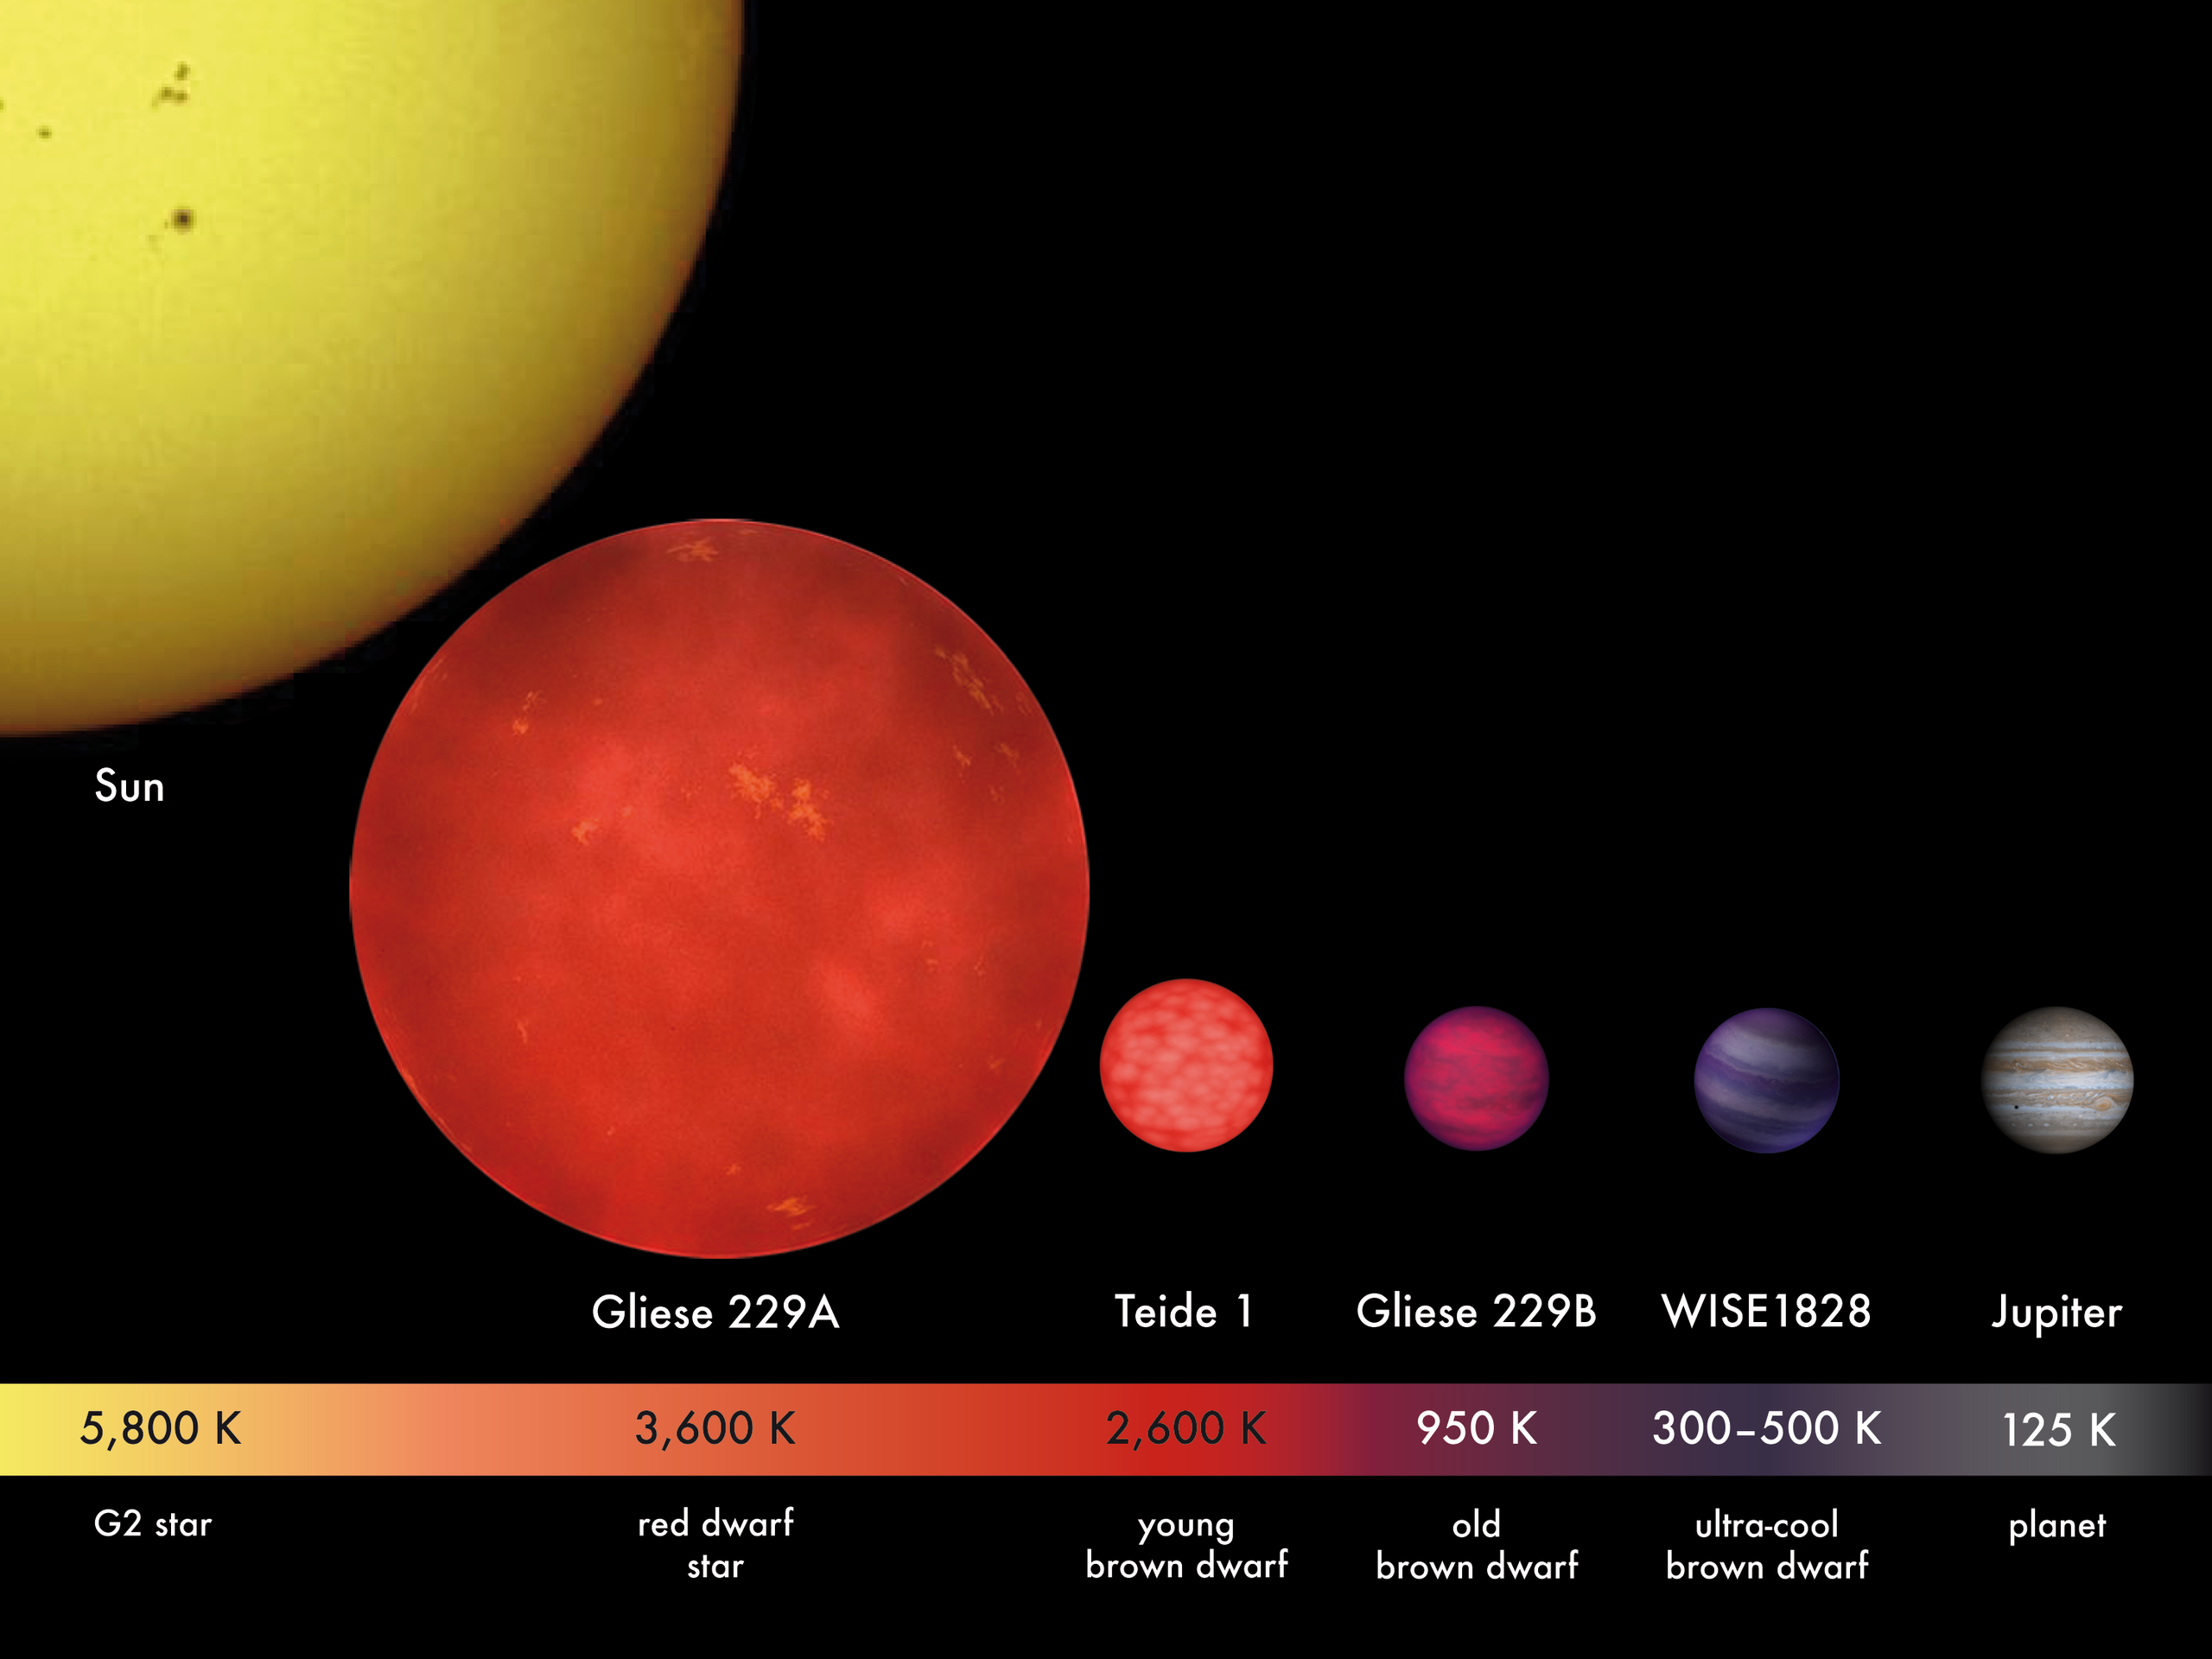
What are Brown Dwarfs?
Substellar objects intermediate between stars and planets (masses 13-80 Jupiter masses)
Spectral types M, L, T, Y
We want to organize data for brown dwarfs…
Notes:
Can be great probes for extrasolar planet research- isolated examples with comparable masses and temperatures

Slide 5
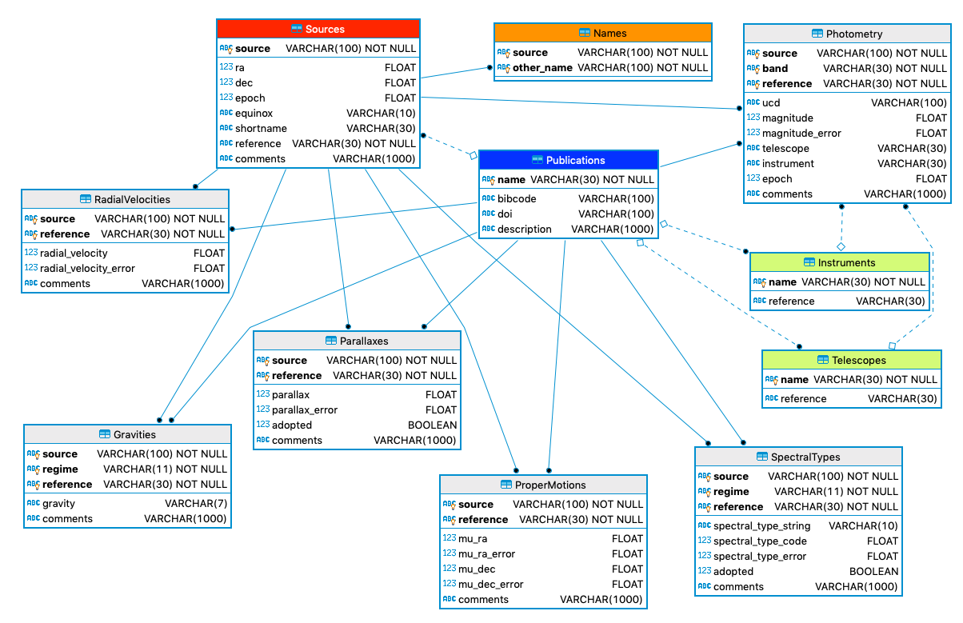
What is SIMPLE?
SIMPLE is a collaborative database of complex objects
Contains several thousand brown dwarfs with photometry, spectra, kinematics, etc
Hosted on GitHub for version control and ease of sharing
Custom UI for quick queries

Slide 6
Do we need a database?
A typical astronomer’s “database”:
A wide-table representation of mixed data
Challenge: what do we do if we need a second parallax measurement for the same source?
Source | Spectral Type | Parallax | Distance | J | H | K
TWA 11 | A0V | 14.13 | 71 | 5.784 | 5.794 | 5.769
2MASS J1139-31 | M8 | 21.41 | 47 | 12.68 | 11.96 | 11.50

Slide 7
Problems with Wide Tables
Do we add new columns?
Do we add new rows?
Source | Spectral Type | Parallax | Parallax2 | Distance | Distance2 | J | H | K
TWA 11 | A0V | 14.13 | 15.24 | 71 | 66 | 5.784 | 5.794 | 5.769
2MASS J1139-31 | M8 | 21.41 |  | 47 |  | 12.68 | 11.96 | 11.50
Source | Spectral Type | Parallax | Distance | J | H | K
TWA 11 | A0V | 14.13 | 71 | 5.784 | 5.794 | 5.769
TWA 11 | A0V | 15.24 | 66 | 5.784 | 5.794 | 5.769
2MASS J1139-31 | M8 | 21.41 | 47 | 12.68 | 11.96 | 11.50

Slide 8

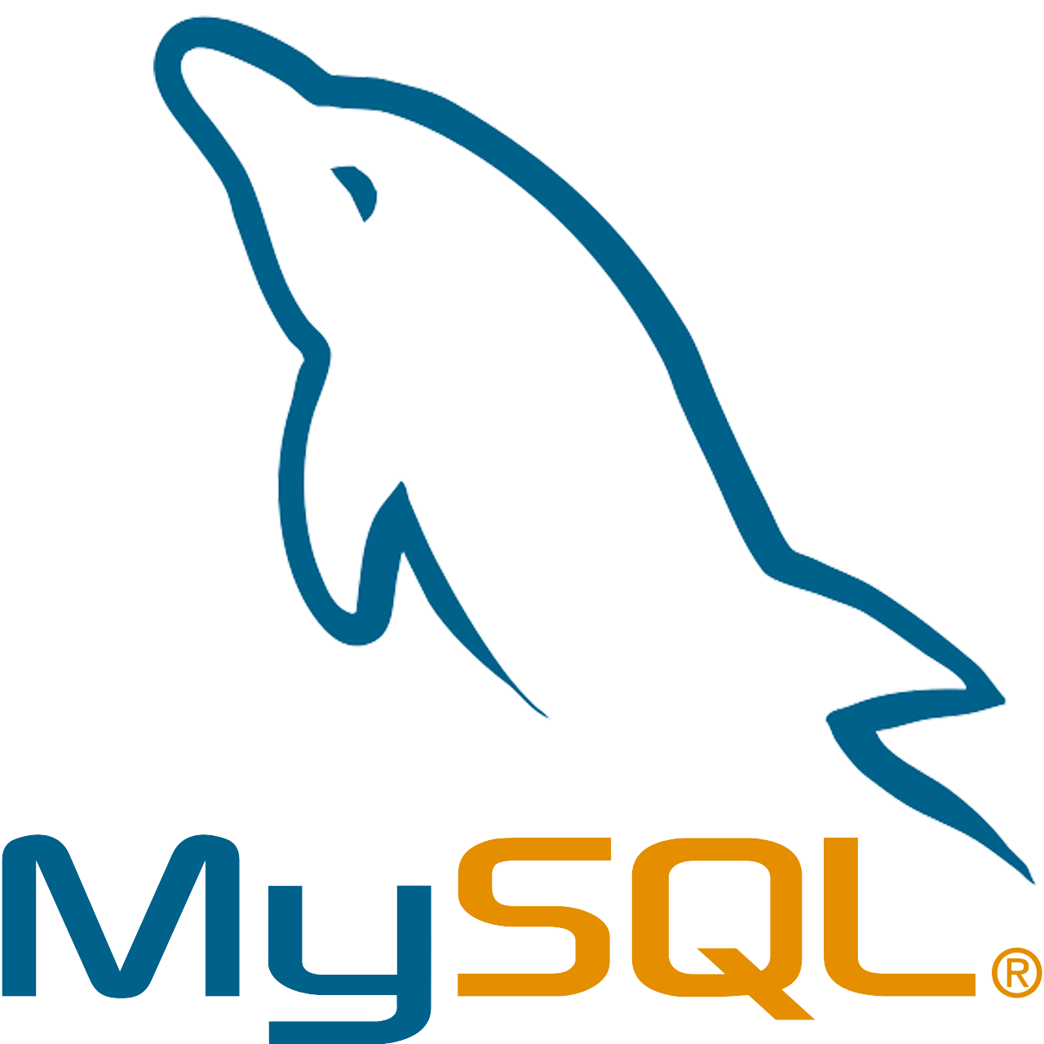
Solution: Graduate to a Database
ID | Filter_ID | Magnitude
1 | 1 | 5.784
1 | 2 | 5.794
1 | 3 | 5.769
2 | 1 | 12.68
2 | 2 | 11.96
2 | 3 | 11.50
ID | Parallax
1 | 14.13
1 | 15.24
2 | 21.41
ID | Source
1 | TWA 11
2 | 2MASS J1139-31
ID | Spectral Type
1 | A0V
2 | M8
This is a relational database and one of the more common types of databases (SQL)
Filter_ID | Filter
1 | J
2 | H
3 | K
Notes:
Tables in third normal form

Slide 9
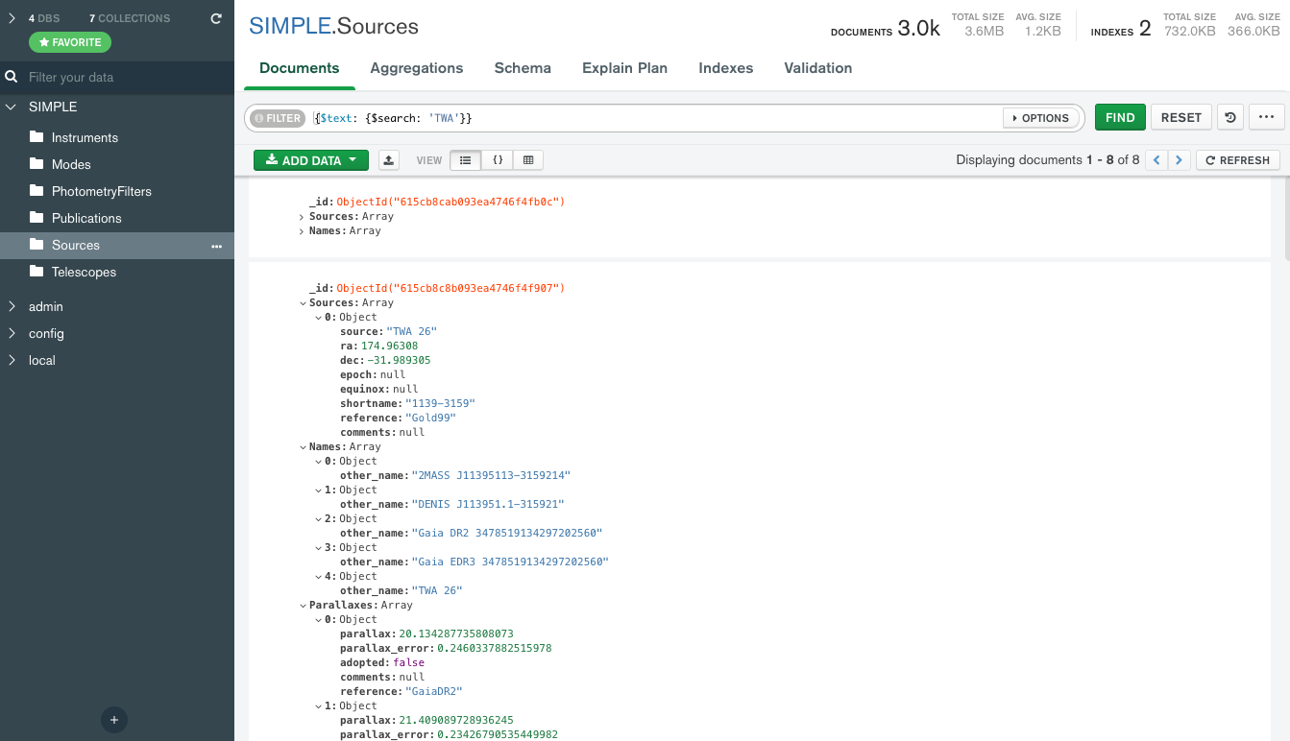

Alternative Databases: NoSQL
Not-only SQL (NoSQL)
Non-tabular database that stores data differently than relational tables
Different models: document-store, key-value, graph, wide-column

Slide 10
SIMPLE and the Astrodb Toolkit
The SIMPLE database is focused on several key use cases:
Collaborative design to allow for multiple users to easily contribute new sources, new data
Support for database sizes up to tens of thousands of sources
Ability to represent complex data models in a simple fashion
Able to access locally on individual machines
Astrodb Toolkit as a solution for these use cases
SIMPLE is a first implementation of this toolkit
Between a standard relational database and a NoSQL database

Slide 11
The SIMPLE Database
A hybrid: document store, for version control and collaboration, and SQL, for versatile queries
Data is stored in JSON format and converted to SQLite or other relational databases
Managed via the AstrodbKit2 python package
Built on top of SQLAlchemy
SQL schema described in Python
Methods provide ways to convert back and forth between formats
Not constrained to brown dwarf science- any field can use AstrodbKit2

Slide 12
The SIMPLE Database
Two “types” of tables:
Object Tables
Sources, Photometry, Spectra, etc. all linked via the source key
Many-to-One relationships (eg, many photometry values for one source)
1 JSON file per Source, with multiple keys for other data
Reference Tables
Publications, Telescopes, Instruments, etc.
Many-to-Many relationships (eg, one or more telescopes can refer to one more sources)
1 JSON file per table

Slide 13
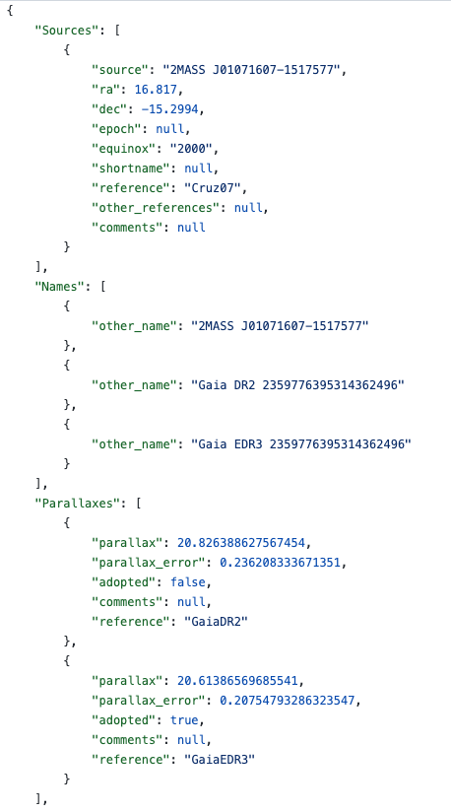
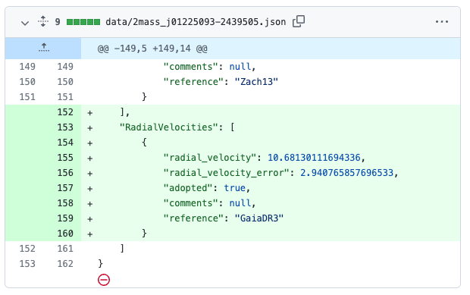
The SIMPLE Database: Document Store

Slide 14
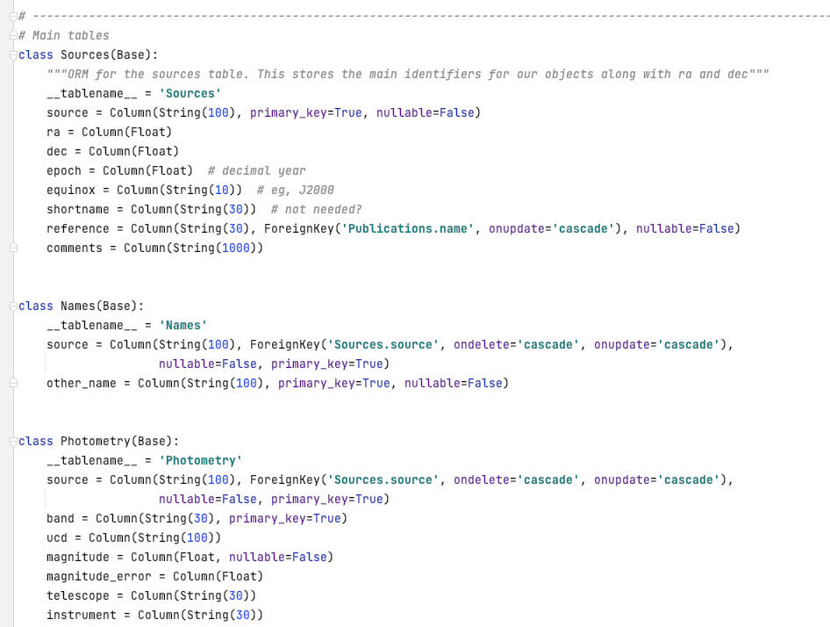
The SIMPLE Database: SQL
source | ra | dec | epoch
source | other_name
source | band | magnitude

Slide 15
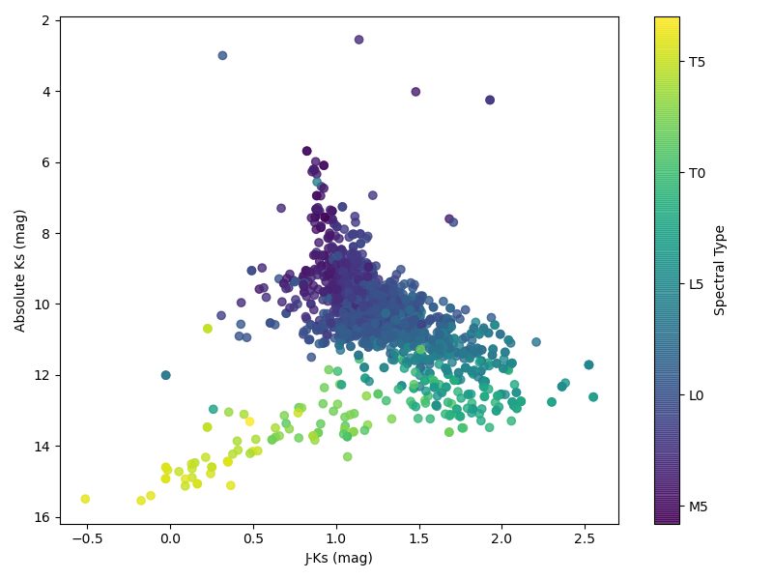
SIMPLE Database Contents
3180 sources spread through across M, L, T, Y spectral types
13,212 photometry measurements
1519 spectra across nearly 20 instruments
Notes:
H2 and CH4 become more prevalent in T dwarfs and suppress the K-band, making them look bluer

Slide 16
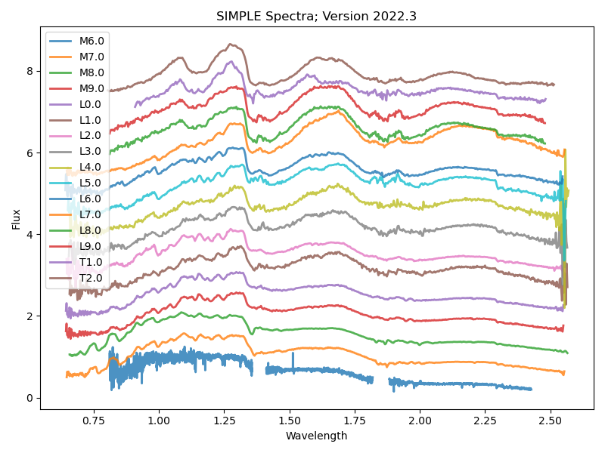
SIMPLE: Handling Spectra
Spectra are stored in the SIMPLE database as pointers to Cloud-hosted files
AstrodbKit2 contains logic to understand which columns it needs to translate into specutils.Spectrum1D objects
Notes:
Keep this slide but simplify it a little bit- we do want to emphasize handling files (so images, posterior distributions, etc will work in the future)

Slide 17
The SIMPLE Software Ecosystem
A set of 4 Github repos linked together
https://github.com/SIMPLE-AstroDB
Manages database queries, including generating the database.
Generic for any database following a similar model.
AstrodbKit2
SIMPLE-db
SIMPLE-binary
SIMPLE-web
Code behind the user interface
http://simple-bd-archive.org/
Specific schema for SIMPLE
Raw JSON data for database
Ingest and tutorial scripts
Copy of database in SQLite format
Generated automatically by SIMPLE-db

Slide 18
The SIMPLE Workflow: Powered by GitHub
Local DB
Implement change
GitHub
Review changes
Run tests
Website
Fetch generated database
Push to GitHub
Trigger automation
Generate JSON
Explore database
Changes to the SIMPLE database, either the schema or the content, follow a standard software development workflow, adapted for databases

Slide 19
The SIMPLE Workflow: Automation
Two types of automation are configured for SIMPLE via GitHub Actions
Pull request against main branch
Unit tests to verify database integrity
GitHub tagged release
Build database and push to SIMPLE-binary

Slide 20
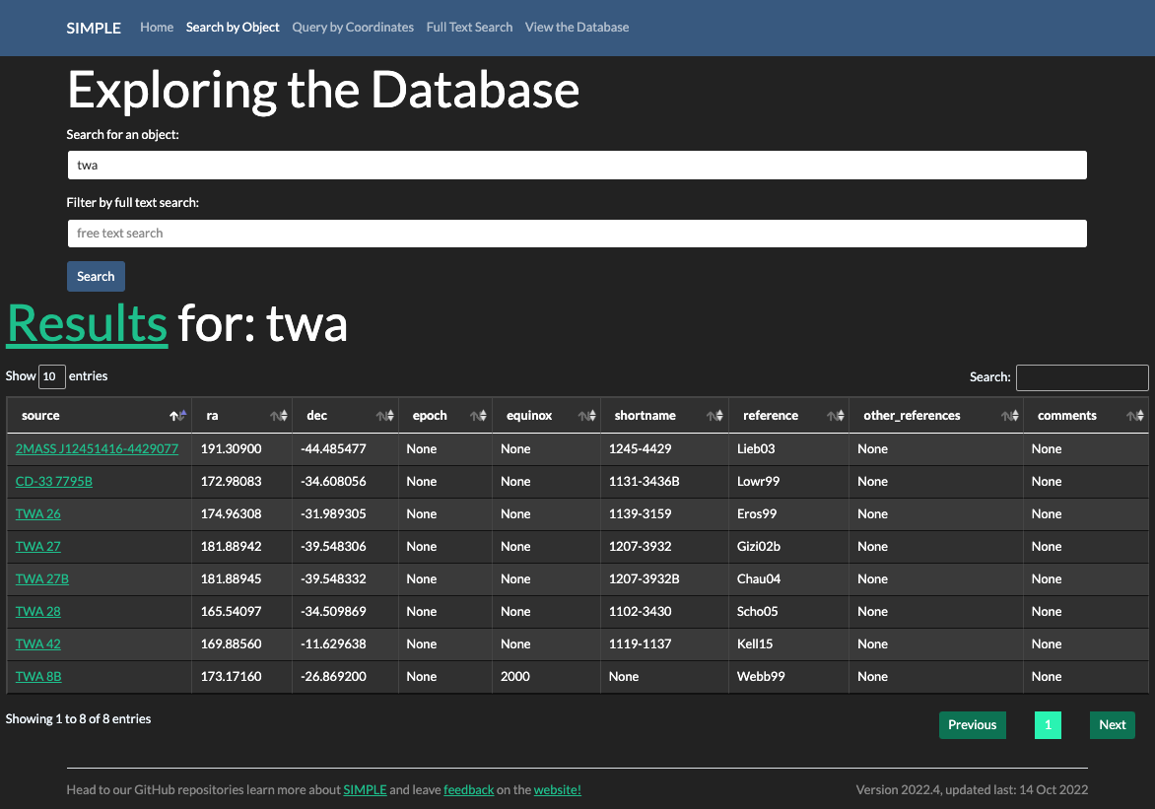
SIMPLE Online
http://simple-bd-archive.org/
Built using Flask on Python with Bokeh for plots
Hosted on Reclaim Cloud

Slide 21
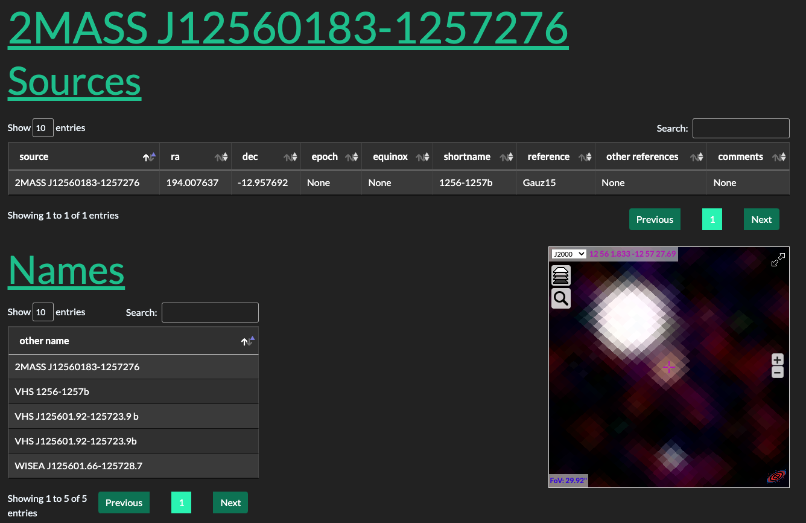

Slide 22
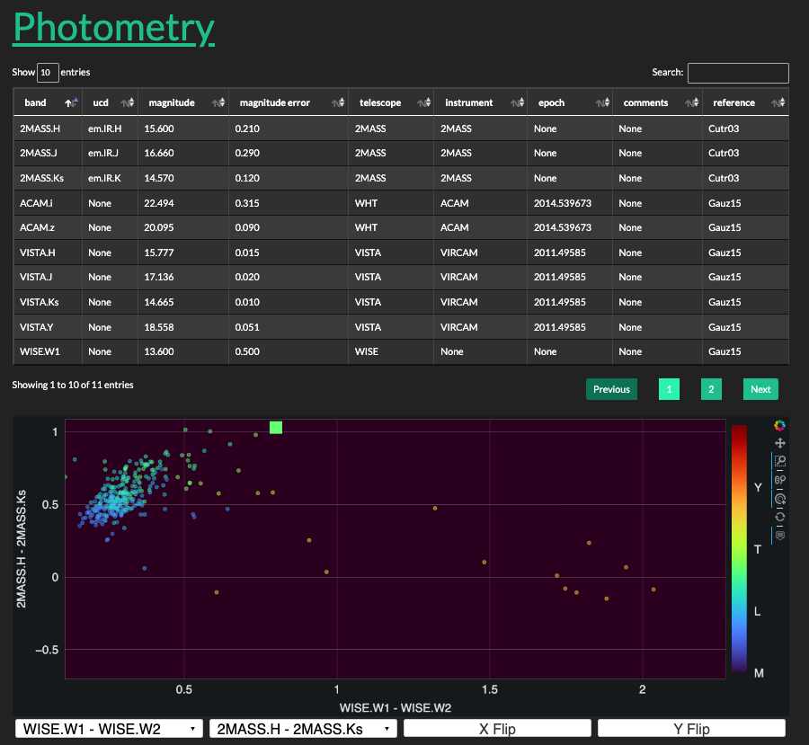

Slide 23
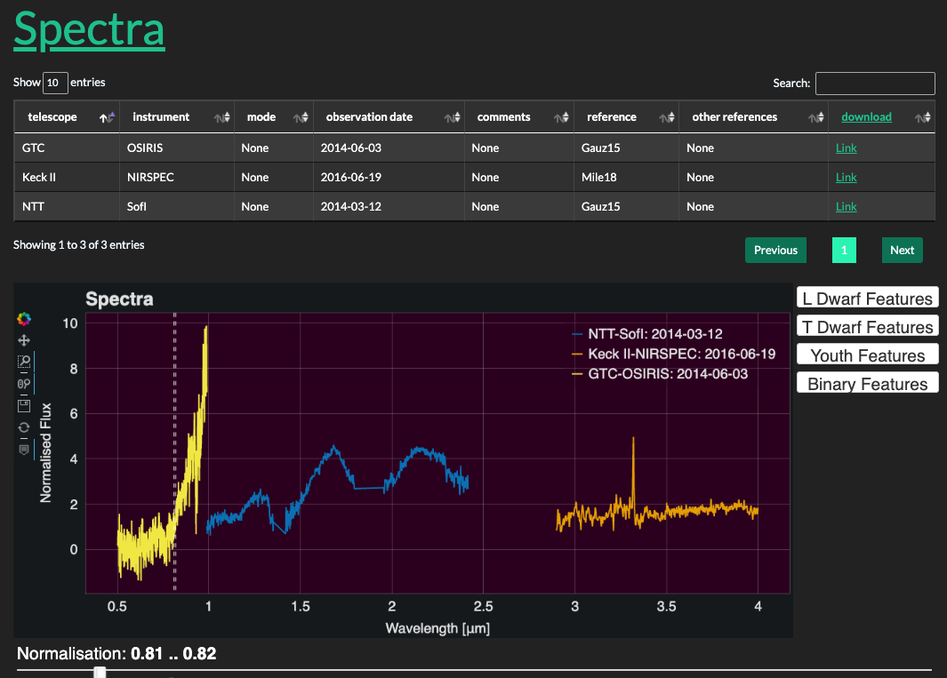

Slide 24
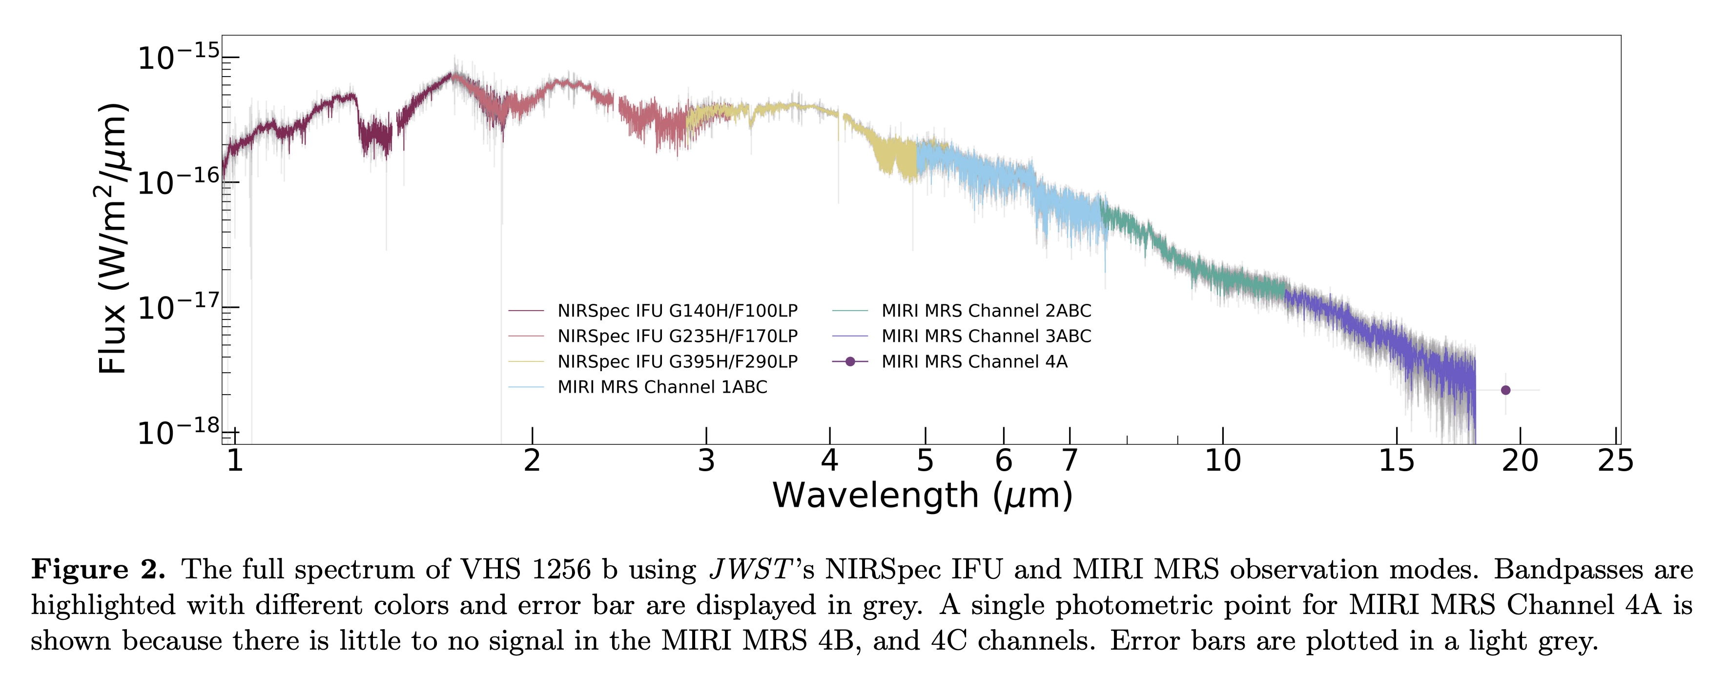
Soon will be adding JWST spectra! (Miles et al. 2022)

Slide 25
Summary
Astrodb Toolkit is a framework for creating collaborative mid-scale databases; first example is SIMPLE
The database is a hybrid of a document store and relational database
GitHub is used for coordinating content updates and running validation and tests
SIMPLE is prototyped for brown dwarf science, but can extend to other fields
https://github.com/SIMPLE-AstroDB

Slide 26
Backup Slides

Slide 27
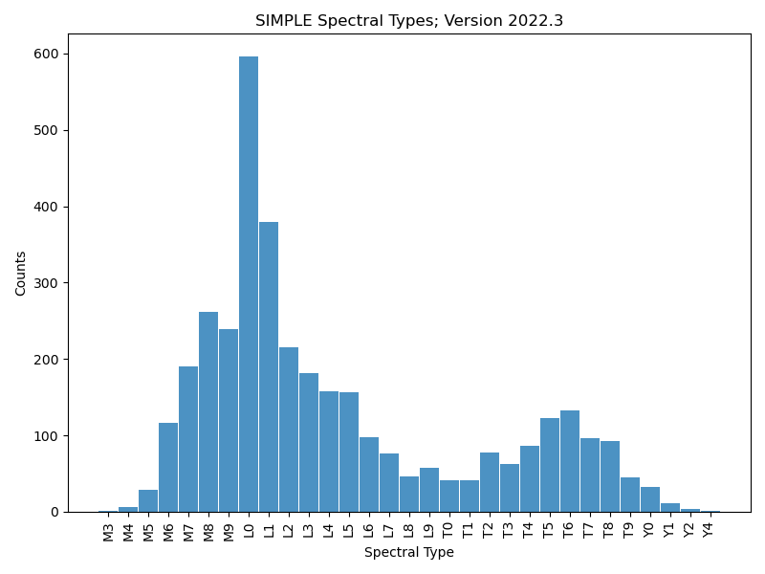
SIMPLE Database Contents
3180 sources spread through across M, L, T, Y spectral types
13,212 photometry measurements
1519 spectra across nearly 20 instruments
# Query for counts grouped by spectral type t = db.query(db.SpectralTypes.c.spectral_type, func.count(db.SpectralTypes.c.source).label('counts')).\ group_by(db.SpectralTypes.c.spectral_type).\ astropy()
Notes:
Move most of these to backup, but have at least one to show how much is in the database (and have a nice plot to go with it)

Slide 28
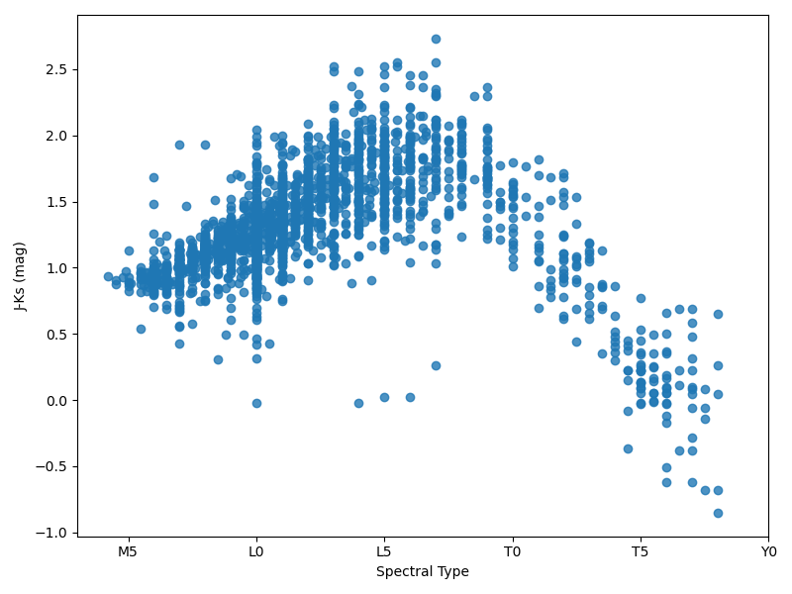
SIMPLE Database Contents
# Query for joint Photometry and Spectral Types
t = db.query(db.Photometry.c.source, db.Photometry.c.band, db.Photometry.c.magnitude, db.SpectralTypes.c.spectral_type_code).\ join(db.SpectralTypes, db.SpectralTypes.c.source == db.Photometry.c.source).\ filter(db.Photometry.c.band.in_(['2MASS.J', '2MASS.H', '2MASS.Ks'])).\ pandas() # Pivoting and handling table t_pivoted = t.pivot_table(index="source", columns="band", values="magnitude") df = t[['source', 'spectral_type_code']].merge(t_pivoted, left_on='source', right_on='source') df = df.drop_duplicates(['source', 'spectral_type_code’])
Notes:
H2 and CH4 become more prevalent in T dwarfs and suppress the K-band, making them look bluer

Slide 29
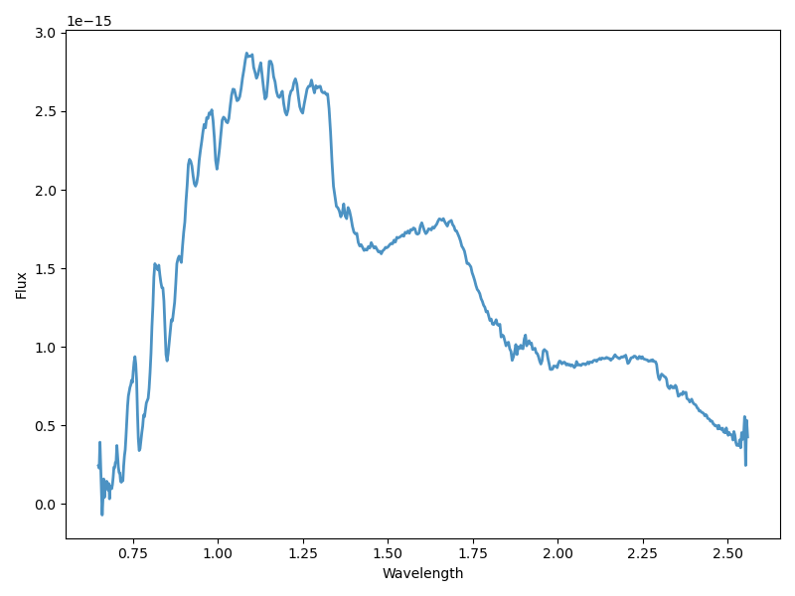
SIMPLE: Handling Spectra
Spectra are stored in the SIMPLE database as pointers to Cloud-hosted files
AstrodbKit2 contains logic to understand which columns it needs to translate into specutils.Spectrum1D objects
t = db.query(db.Spectra.c.spectrum).\
filter(db.Spectra.c.source == '2MASS J00192626+4614078’).\
limit(1).\
spectra()
Notes:
Keep this slide but simplify it a little bit- we do want to emphasize handling files (so images, posterior distributions, etc will work in the future)

Slide 30
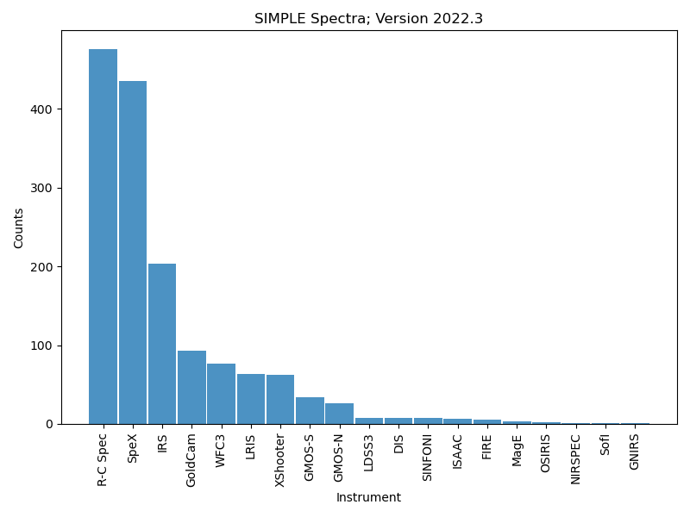
SIMPLE Database Contents

Slide 31
SIMPLE Database Contents
# Query for Photometry, Spectral Types, Parallaxes
t = db.query(db.Photometry.c.source, db.Photometry.c.band, db.Photometry.c.magnitude, db.Parallaxes.c.parallax, db.SpectralTypes.c.spectral_type_code). \ join(db.Parallaxes, db.Parallaxes.c.source == db.Photometry.c.source). \ join(db.SpectralTypes, db.SpectralTypes.c.source == db.Photometry.c.source). \ filter(db.Photometry.c.band.in_(['2MASS.J', '2MASS.H', '2MASS.Ks'])). \ filter(db.Parallaxes.c.adopted == 1). \ pandas() # Pivoting and creating helper columns t_pivoted = t.pivot_table(index="source", columns="band", values="magnitude") df = t[['source', 'parallax', 'spectral_type_code']].merge(t_pivoted, left_on='source', right_on='source') df = df.drop_duplicates(['source', 'spectral_type_code']) df['distance'] = 1000./df['parallax'] df['dm'] = 5 * np.log10(df['distance'] / 10)

